Slide 1
How to Share Your Testimony
Dr. Rick Griffith • Jordan Evangelical Theological Seminary • BibleStudyDownloads.org

Slide 2
Speaking Progression
vii
Introduction (1 min.)
Personal Testimony (2-3 min.)
Persuasion Speech (2 min.)
Epistle Sermon (15 min.)
Narrative Sermon (15 min.)
Notes:
Same slide for presentation 01.54 and 02.07 so translators may copy from one to the other

Slide 3
Why share your testimony?
16
Easy to talk about yourself
You are the expert
Chance to share what you have learned
People like to hear personal stories
Helps you get to know God better
Helps you see what God has done
Evangelism opportunities
Helps others relate to you
People cannot rebut your story
Notes:
Same slide for presentation 01.49 and 02.03 so translators may copy from one to the other except that 02.03 expands the 01.49 slide

Slide 4
Testimony Flow
16
Post-Conversion:
Your thinking
Specific changes
Be concrete!
Conversion:
Share the event
What you believed
Be concrete!
Pre-Conversion:
Your thinking
Your actions
Be concrete!
Keep the same theme throughout!
Notes:
Same slide for presentation 01.50 and 02.04 so translators may copy from one to the other

Slide 5
My Testimony
19
Post-Conversion:
Peace
Security
Love for people
Conversion:
Youth gathering
Jesus is God's Gift
"I stop 'earning'"
Pre-Conversion:
Good works
"Confident"
Insecure
Keeps the same security theme throughout!

Slide 6
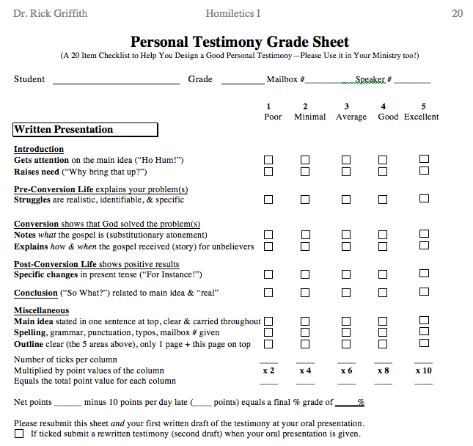
Testimony Grade Sheet
20
Introduction
Pre-Conversion
Conversion
Post-Conversion
Conclusion
Miscellaneous

Slide 7
Black

Slide 8
Preaching (Homiletics) link at BibleStudyDownloads.org
Get this presentation for free!
Notes:
Preaching (pr)
Homiletics

